Slide 1
Kids
Song

Slide 2
I’ve been redeemed
(I’ve been redeemed)
By the blood of the lamb
(By the blood of the lamb)
I’ve been redeemed by the blood of the lamb
I’ve been redeemed by the blood of the lamb
Save by the Holy Ghost I am
All my sins are washed away
I’ve been redeemed

Slide 3
Oh, You can’t get to Heaven
(Oh, You can’t get to Heaven)
On roller skates
(On roller skates)
Oh, You can’t get to Heaven on roller skates
Oh, You can’t get to Heaven on roller skates
‘Cause you’ll roll right past those pearly gates
All my sins are washed away
I’ve been redeemed

Slide 4
Oh, You can’t get to Heaven
(Oh, You can’t get to Heaven)
In a limousine
(In a limousine)
Oh, You can’t get to Heaven in a limousine
Oh, You can’t get to Heaven in a limousine
‘Cause Heaven ain’t got no gasoline
All my sins are washed away
I’ve been redeemed

Slide 5
Oh, You can’t get to Heaven
(Oh, You can’t get to Heaven)
In a shopping cart
(In a shopping cart)
Oh, You can’t get to Heaven In a shopping cart
Oh, You can’t get to Heaven In a shopping cart
‘Cause Heaven ain’t got no WalMart
All my sins are washed away
I’ve been redeemed

Slide 6
Oh, You can’t get to Heaven
(Oh, You can’t get to Heaven)
In a taco shell
(In a taco shell)
Oh, You can’t get to Heaven In a taco shell
Oh, You can’t get to Heaven In a taco shell
‘Cause Heaven ain’t got no Taco Bell
All my sins are washed away
I’ve been redeemed

Slide 7
The Gate
Chase Pratt
Romeo Church of Christ
2/16/20

Slide 8
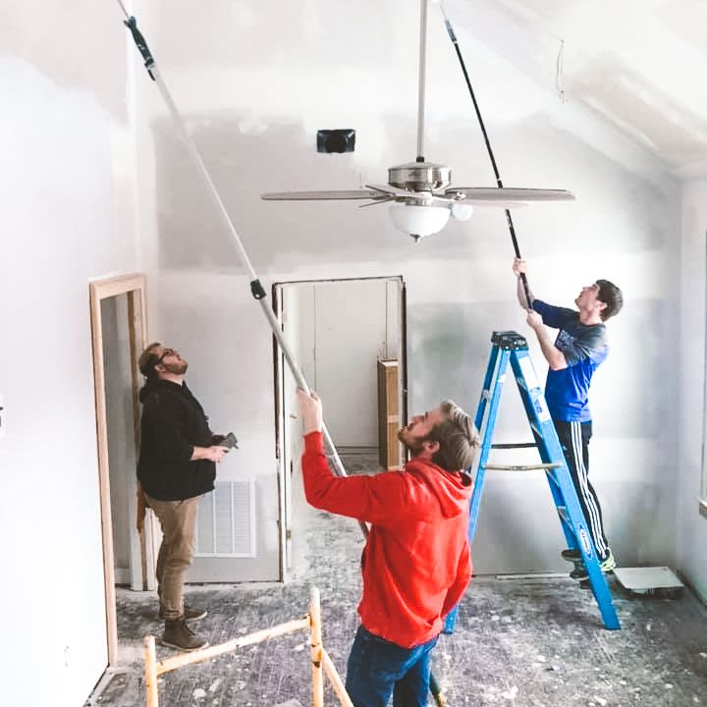
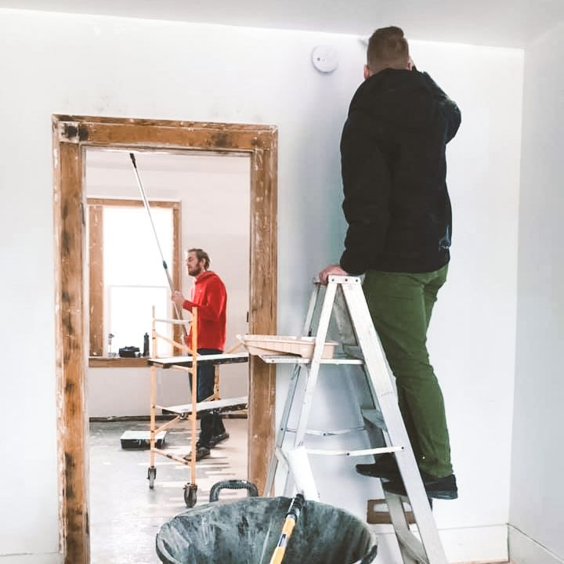
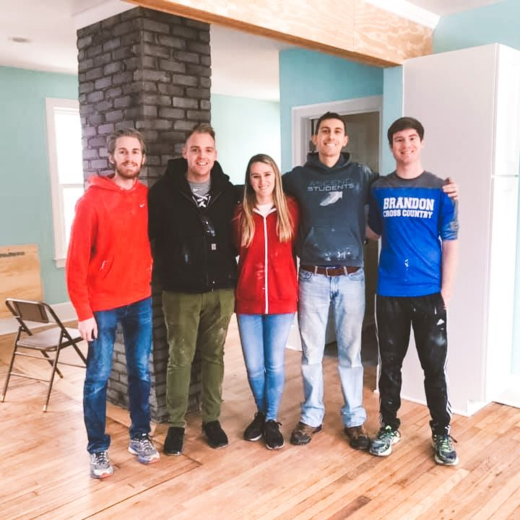

Slide 9
Amazon.com Charity Lists:
End of the Road
https://smile.amazon.com/hz/charitylist/ls/1Z208VHFTDPBD/ref=smi_ext_lnk_lcl_cl

Slide 10
John 10:7-10
Therefore Jesus said again, “Very truly I tell you, I am the gate for the sheep. ⁸ All who have come before me are thieves and robbers, but the sheep have not listened to them. ⁹ I am the gate; whoever enters through me will be saved. They will come in and go out, and find pasture. ¹⁰ The thief comes only to steal and kill and destroy; I have come that they may have life, and have it to the full.

Slide 11
John 14:5-7
Thomas said to him, “Lord, we don’t know where you are going, so how can we know the way?”
⁶ Jesus answered, “I am the way and the truth and the life. No one comes to the Father except through me. ⁷ If you really know me, you will know my Father as well. From now on, you do know him and have seen him.”

Slide 12
Psalm 118:19-21
Open for me the gates of the righteous; I will enter and give thanks to the Lord. ²⁰ This is the gate of the Lord through which the righteous may enter. ²¹ I will give you thanks, for you answered me; you have become my salvation.

Slide 13
Psalm 118:22-24
The stone the builders rejected has become the cornerstone; ²³ the Lord has done this, and it is marvelous in our eyes. ²⁴ The Lord has done it this very day; let us rejoice today and be glad.

Slide 14
Matthew 23:13
Woe to you, teachers of the law and Pharisees, you hypocrites! You shut the door of the kingdom of heaven in people’s faces. You yourselves do not enter, nor will you let those enter who are trying to.

Slide 15
Ecclesiology is Christology

Slide 16
The Gate
Chase Pratt
Romeo Church of Christ
2/16/20

