Slide 1
The Good Shepherd
Chase Pratt
Romeo Church of Christ
2/23/20

Slide 2
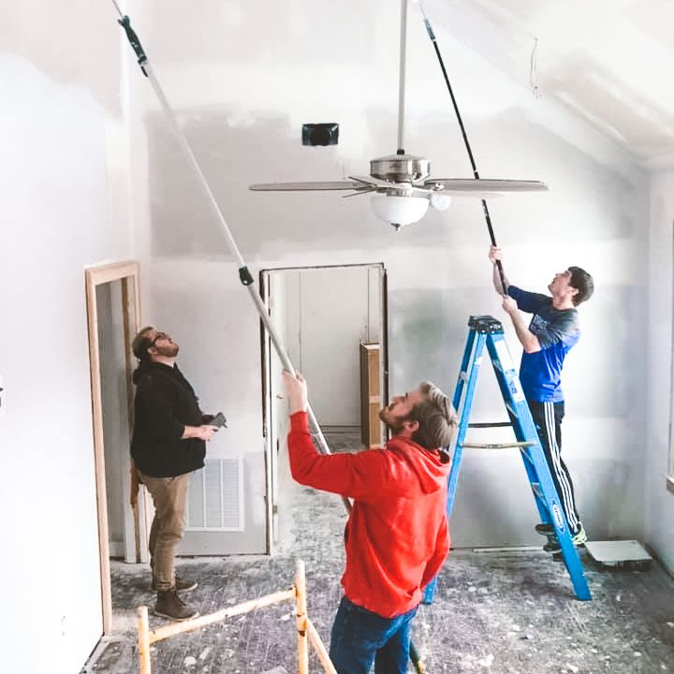
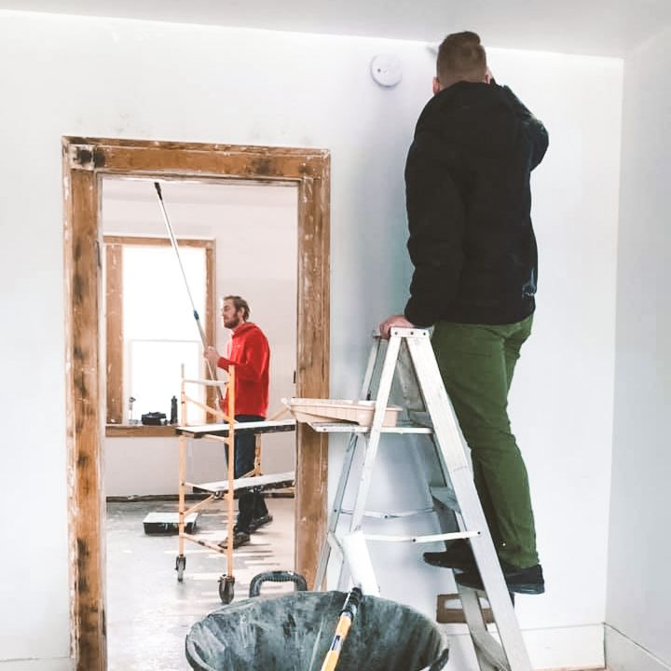
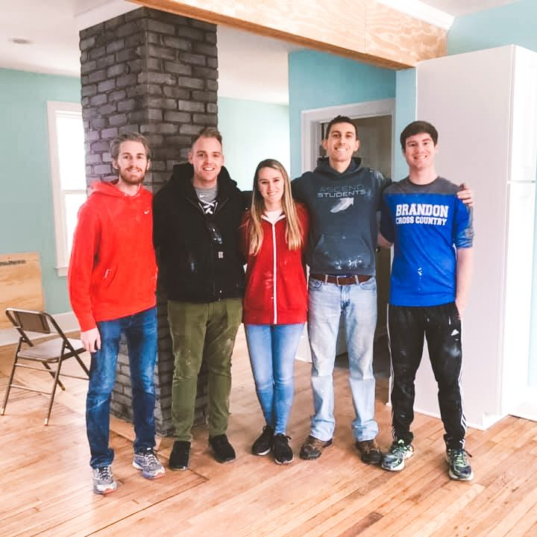
Amazon.com Charity Lists:
End of the Road
tinyurl.com/hopehouselist

Slide 3
The Good Shepherd
Chase Pratt
Romeo Church of Christ
2/23/20

Slide 4
John 10:3-5
The gatekeeper opens the gate for him, and the sheep listen to his voice. He calls his own sheep by name and leads them out. ⁴ When he has brought out all his own, he goes on ahead of them, and his sheep follow him because they know his voice. ⁵ But they will never follow a stranger; in fact, they will run away from him because they do not recognize a stranger’s voice.

Slide 5
John 10:14-16
I am the good shepherd; I know my sheep and my sheep know me— ¹⁵ just as the Father knows me and I know the Father—and I lay down my life for the sheep. ¹⁶ I have other sheep that are not of this sheep pen. I must bring them also. They too will listen to my voice, and there shall be one flock and one shepherd.

Slide 6
John 5:24-27
Very truly I tell you, whoever hears my word and believes him who sent me has eternal life and will not be judged but has crossed over from death to life. ²⁵ Very truly I tell you, a time is coming and has now come when the dead will hear the voice of the Son of God and those who hear will live. ²⁶ For as the Father has life in himself, so he has granted the Son also to have life in himself. ²⁷ And he has given him authority to judge because he is the Son of Man.

Slide 7
John 5:28-29
“Do not be amazed at this, for a time is coming when all who are in their graves will hear his voice ²⁹ and come out—those who have done what is good will rise to live, and those who have done what is evil will rise to be condemned.

Slide 8
John 10:25-28
Jesus answered, “I did tell you, but you do not believe. The works I do in my Father’s name testify about me, ²⁶ but you do not believe because you are not my sheep. ²⁷ My sheep listen to my voice; I know them, and they follow me. ²⁸ I give them eternal life, and they shall never perish; no one will snatch them out of my hand.

Slide 9
John 5:37-40
All those the Father gives me will come to me, and whoever comes to me I will never drive away. ³⁸ For I have come down from heaven not to do my will but to do the will of him who sent me. ³⁹ And this is the will of him who sent me, that I shall lose none of all those he has given me, but raise them up at the last day. ⁴⁰ For my Father’s will is that everyone who looks to the Son and believes in him shall have eternal life, and I will raise them up at the last day.

Slide 10
John 10:25-28
Jesus answered, “I did tell you, but you do not believe. The works I do in my Father’s name testify about me, ²⁶ but you do not believe because you are not my sheep. ²⁷ My sheep listen to my voice; I know them, and they follow me. ²⁸ I give them eternal life, and they shall never perish; no one will snatch them out of my hand.

Slide 11
John 20:11-13
Now Mary stood outside the tomb crying. As she wept, she bent over to look into the tomb ¹² and saw two angels in white, seated where Jesus’ body had been, one at the head and the other at the foot.
¹³ They asked her, “Woman, why are you crying?”
“They have taken my Lord away,” she said, “and I don’t know where they have put him.”

Slide 12
John 20:14-16
At this, she turned around and saw Jesus standing there, but she did not realize that it was Jesus.
¹⁵ He asked her, “Woman, why are you crying? Who is it you are looking for?”
Thinking he was the gardener, she said, “Sir, if you have carried him away, tell me where you have put him, and I will get him.”
¹⁶ Jesus said to her, “Mary.”
She turned toward him and cried out in Aramaic, “Rabboni!” (which means “Teacher”).

Slide 13
John 10:3-5
The gatekeeper opens the gate for him, and the sheep listen to his voice. He calls his own sheep by name and leads them out. ⁴ When he has brought out all his own, he goes on ahead of them, and his sheep follow him because they know his voice. ⁵ But they will never follow a stranger; in fact, they will run away from him because they do not recognize a stranger’s voice.

Slide 14
John 11:21
“Lord,” Martha said to Jesus, “if you had been here, my brother would not have died.”

Slide 15
John 11:21, 32
“Lord,” Martha said to Jesus, “if you had been here, my brother would not have died.”
When Mary reached the place where Jesus was and saw him, she fell at his feet and said, “Lord, if you had been here, my brother would not have died.”

Slide 16
John 11:21, 32, 37
“Lord,” Martha said to Jesus, “if you had been here, my brother would not have died.”
When Mary reached the place where Jesus was and saw him, she fell at his feet and said, “Lord, if you had been here, my brother would not have died.”
But some of them said, “Could not he who opened the eyes of the blind man have kept this man from dying?”

Slide 17
John 5:28-29
“Do not be amazed at this, for a time is coming when all who are in their graves will hear his voice ²⁹ and come out—those who have done what is good will rise to live, and those who have done what is evil will rise to be condemned.

Slide 18
John 21:18-19
Very truly I tell you, when you were younger you dressed yourself and went where you wanted; but when you are old you will stretch out your hands, and someone else will dress you and lead you where you do not want to go.” ¹⁹ Jesus said this to indicate the kind of death by which Peter would glorify God. Then he said to him, “Follow me!”

Slide 19
John 21:22-24
Jesus answered, “If I want him to remain alive until I return, what is that to you? You must follow me.” ²³ Because of this, the rumor spread among the believers that this disciple would not die. But Jesus did not say that he would not die; he only said, “If I want him to remain alive until I return, what is that to you?”
²⁴ This is the disciple who testifies to these things and who wrote them down. We know that his testimony is true.

Slide 20
John 20:30-31
Jesus performed many other signs in the presence of his disciples, which are not recorded in this book. ³¹ But these are written that you may keep believing that Jesus is the Messiah, the Son of God, and that by believing you may have life in his name.

