Slide 1
A Troublemaker on Trial
Chase Pratt
Romeo Church of Christ
12/15/18

Slide 2
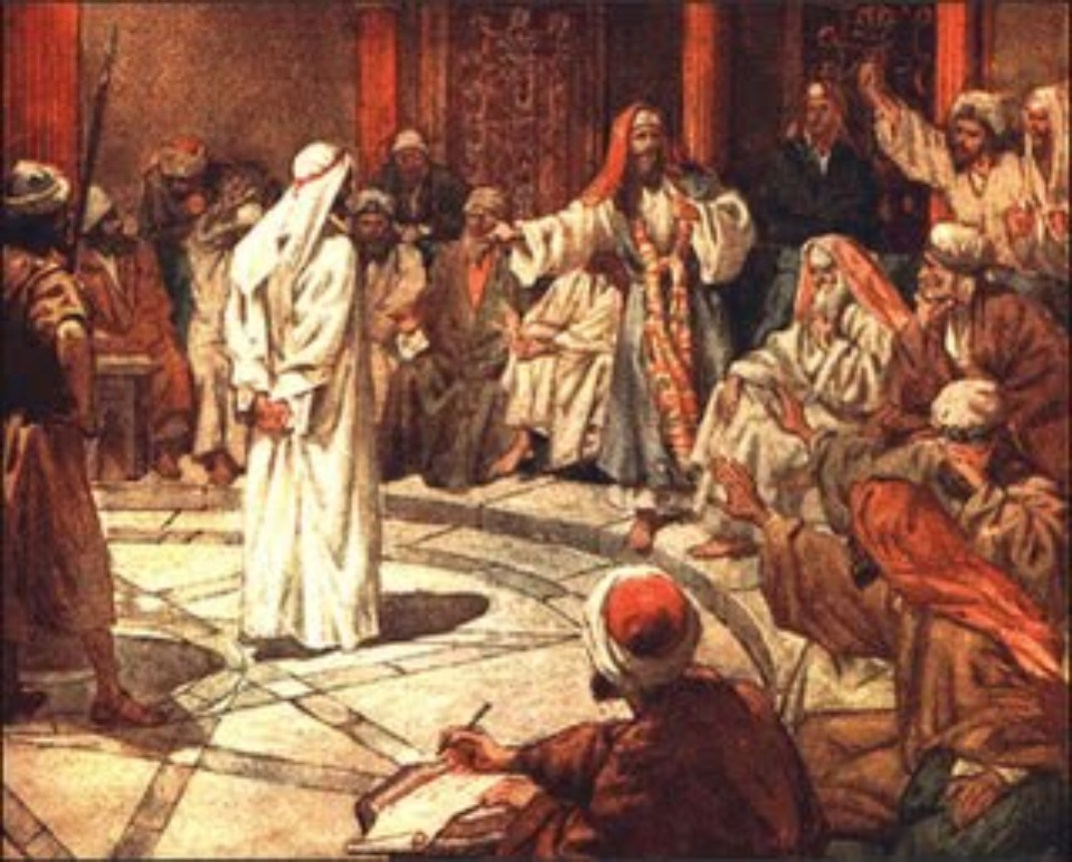

Slide 3
“The Jews”

Slide 4
Acts 23:6-8
Then Paul, knowing that some of them were Sadducees and the others Pharisees, called out in the Sanhedrin, “My brothers, I am a Pharisee, descended from Pharisees. I stand on trial because of the hope of the resurrection of the dead.” ⁷ When he said this, a dispute broke out between the Pharisees and the Sadducees, and the assembly was divided. ⁸ (The Sadducees say that there is no resurrection, and that there are neither angels nor spirits, but the Pharisees believe all these things.)

Slide 5
Acts 23:9-10
There was a great uproar, and some of the teachers of the law who were Pharisees stood up and argued vigorously. “We find nothing wrong with this man,” they said. “What if a spirit or an angel has spoken to him?” ¹⁰ The dispute became so violent that the commander was afraid Paul would be torn to pieces by them. He ordered the troops to go down and take him away from them by force and bring him into the barracks.

Slide 6
Acts 23:26-29
Claudius Lysias,
To His Excellency, Governor Felix:
Greetings.
²⁷ This man was seized by the Jews and they were about to kill him, but I came with my troops and rescued him, for I had learned that he is a Roman citizen. ²⁸ I wanted to know why they were accusing him, so I brought him to their Sanhedrin. ²⁹ I found that the accusation had to do with questions about their law, but there was no charge against him that deserved death or imprisonment

Slide 7
Acts 24:6-8
“We have found this man to be a troublemaker, stirring up riots among the Jews all over the world. He is a ringleader of the Nazarene sect ⁶ and even tried to desecrate the temple; so we seized him. ⁸ By examining him yourself you will be able to learn the truth about all these charges we are bringing against him.”

Slide 9
“The Christians”

Slide 10
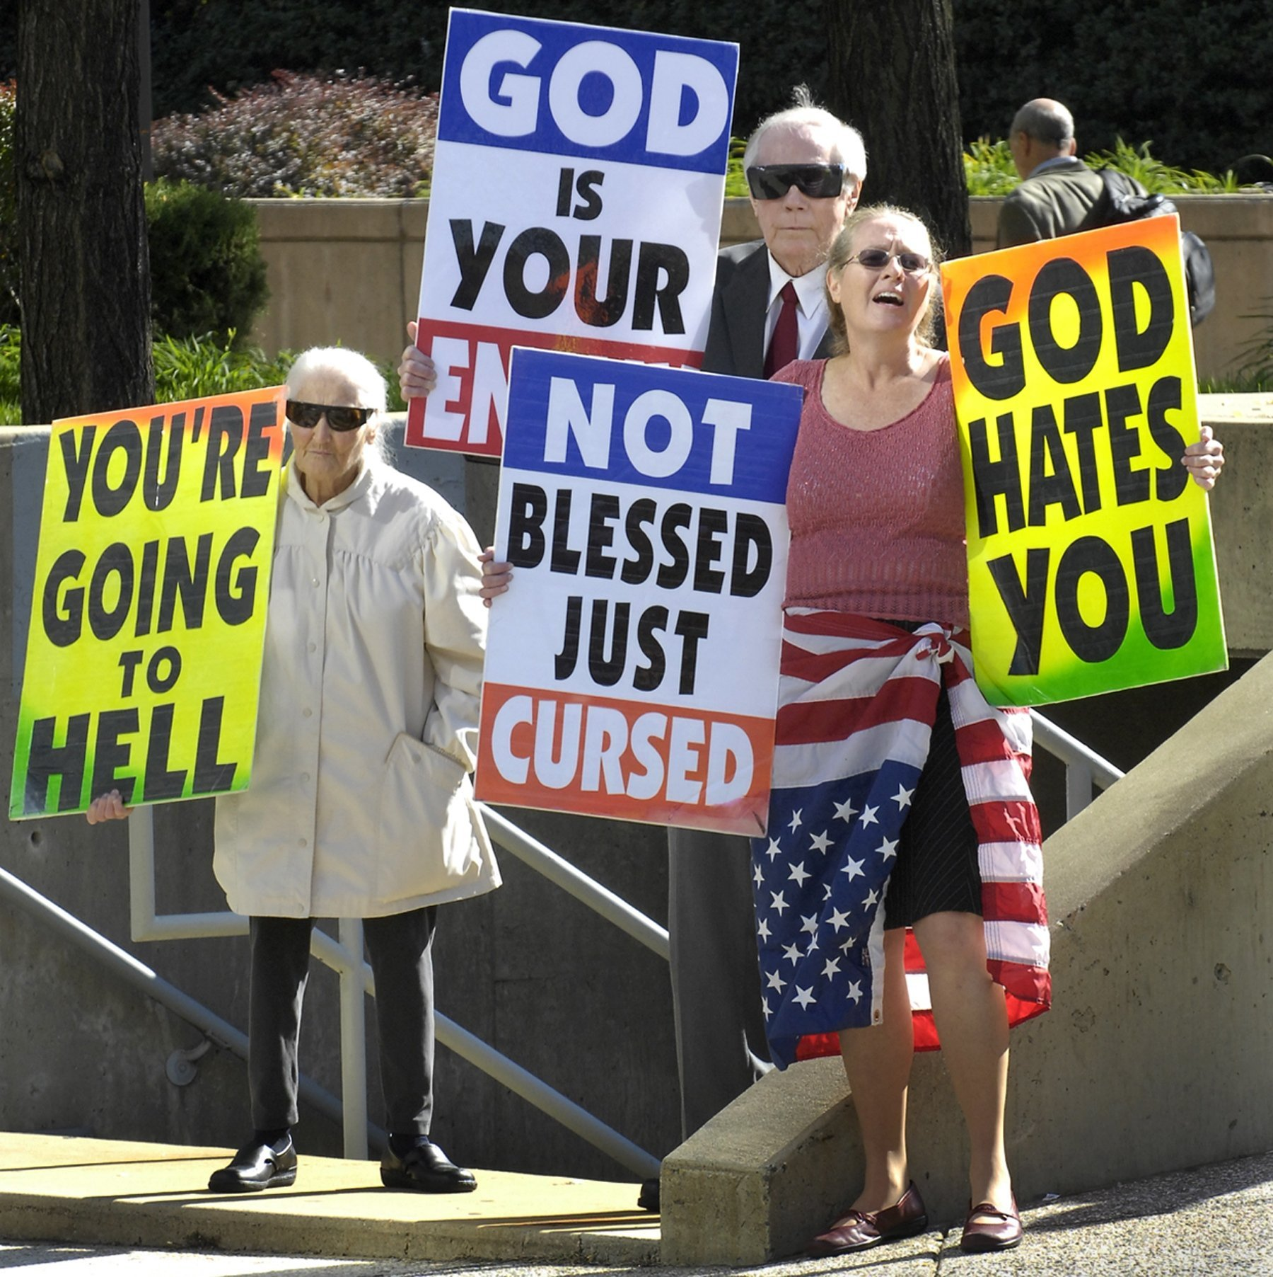

Slide 11
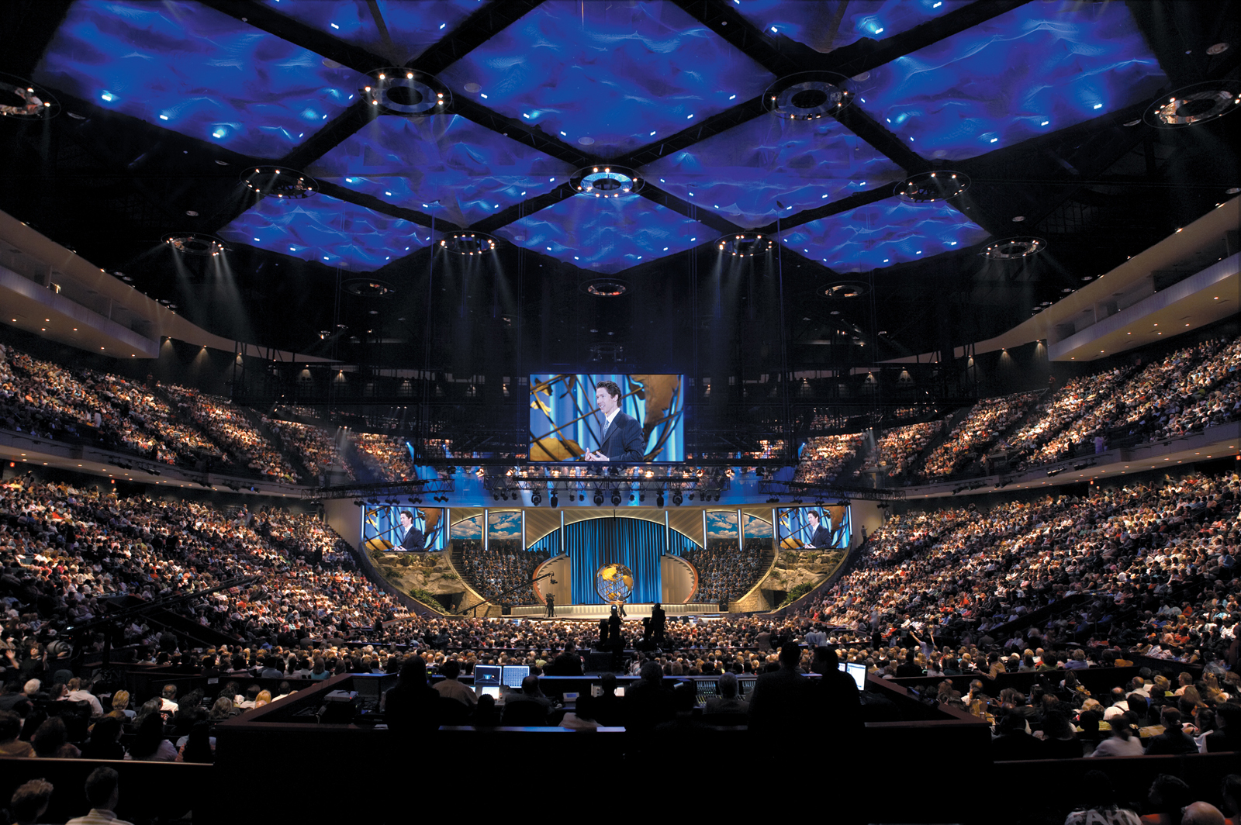

Slide 15
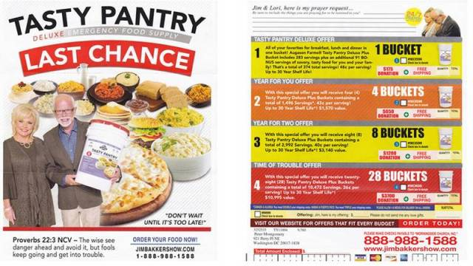

Slide 16
