Slide 1
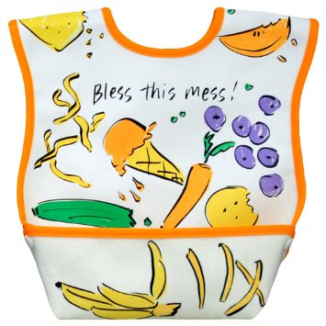

Slide 2
Hebrews 12:1-3
Therefore, since we are surrounded by such a great cloud of witnesses, let us throw off everything that hinders and the sin that so easily entangles. And let us run with perseverance the race marked out for us, ² fixing our eyes on Jesus, the pioneer and perfecter of faith. For the joy set before him he endured the cross, scorning its shame, and sat down at the right hand of the throne of God. ³ Consider him who endured such opposition from sinners, so that you will not grow weary and lose heart.

Slide 3
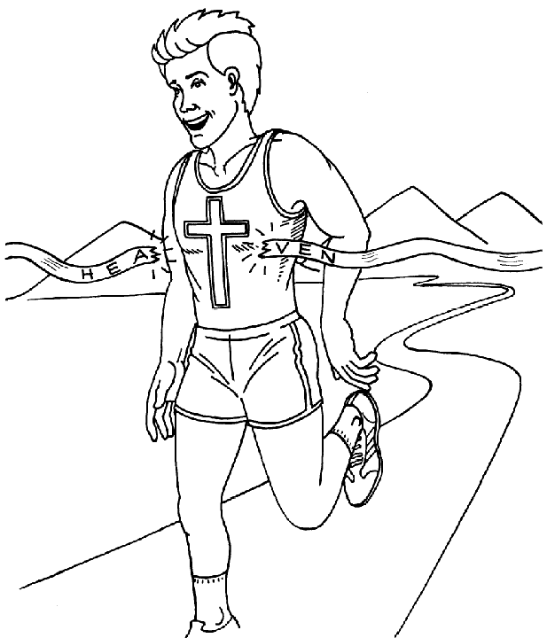
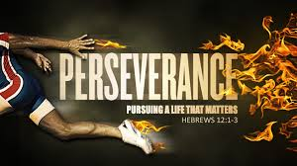
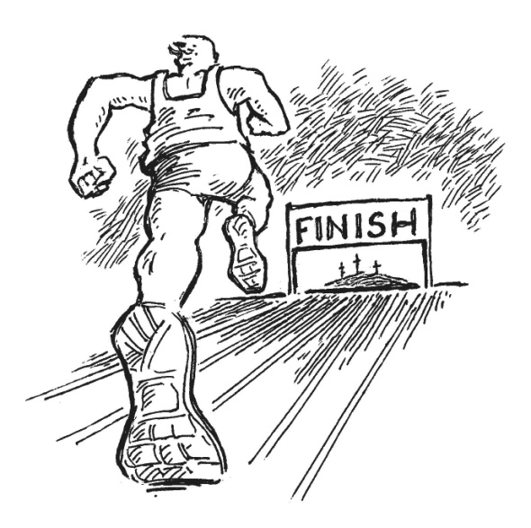
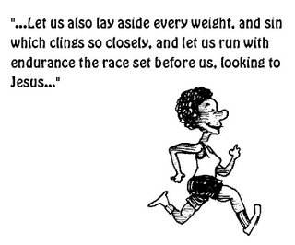

Slide 4
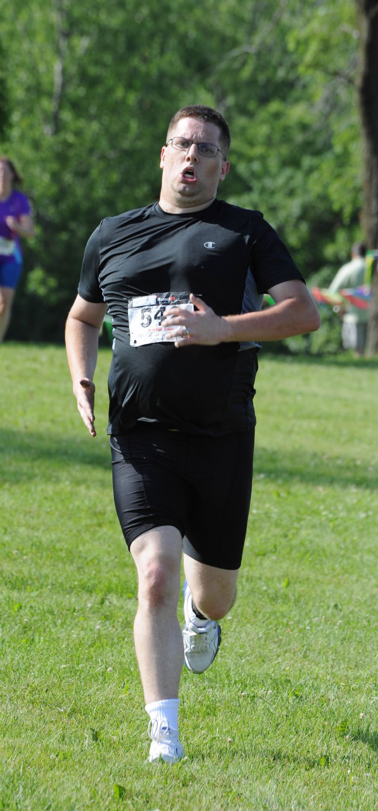
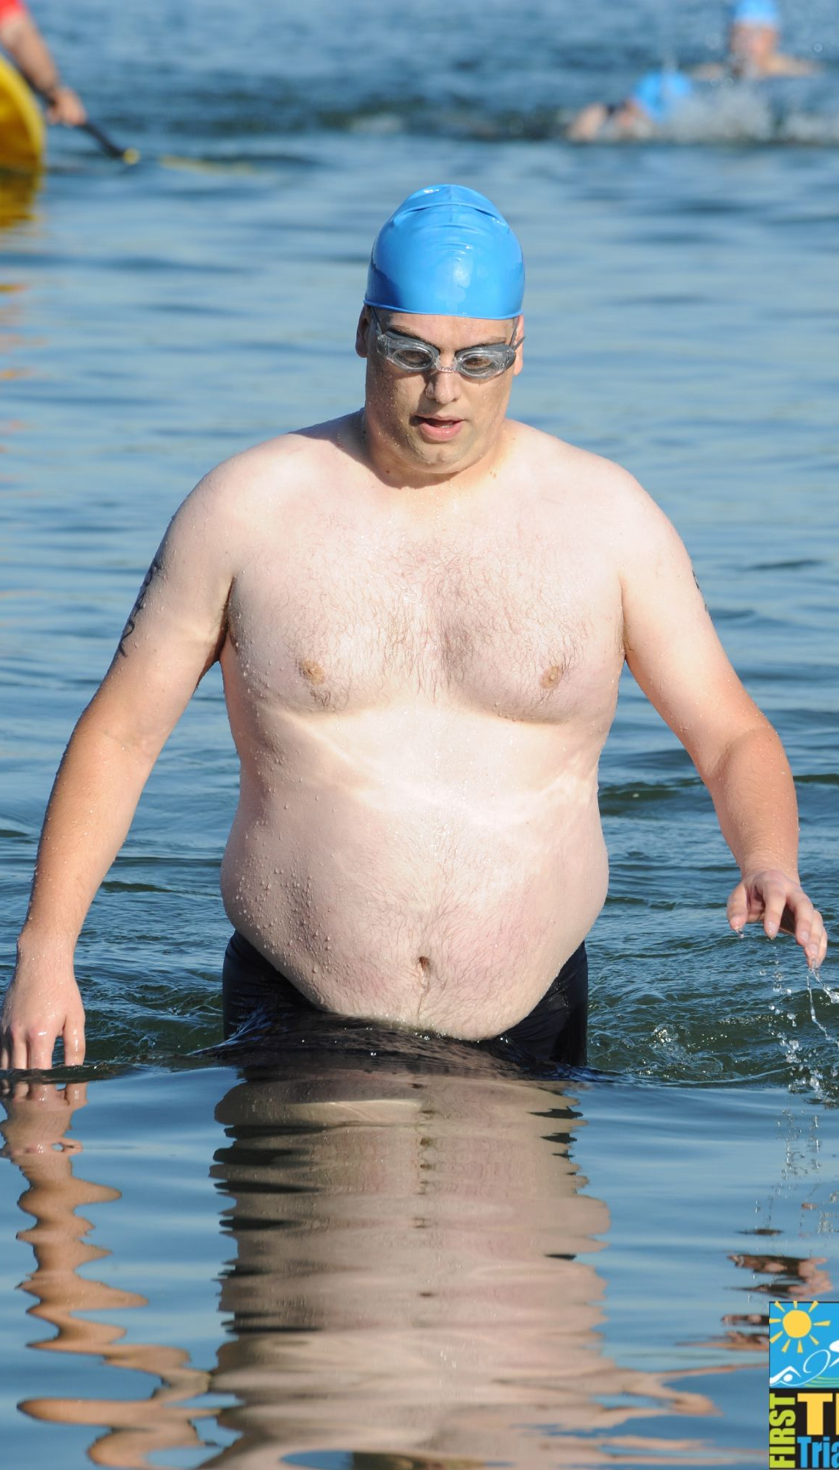
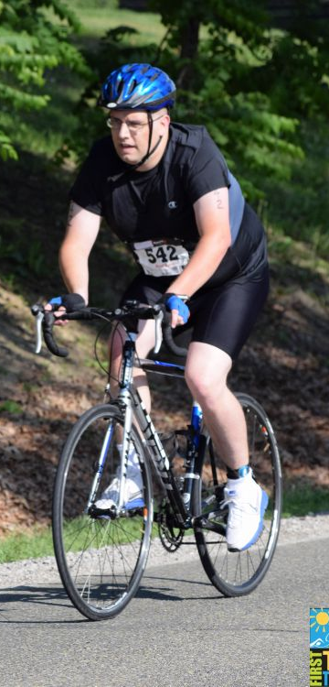

Slide 7
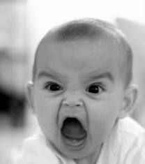
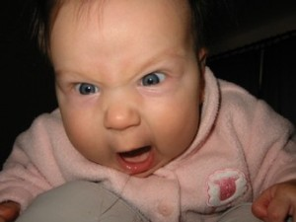
James and John

Slide 8
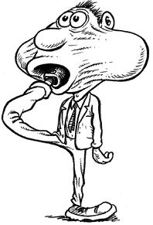
Peter

Slide 9
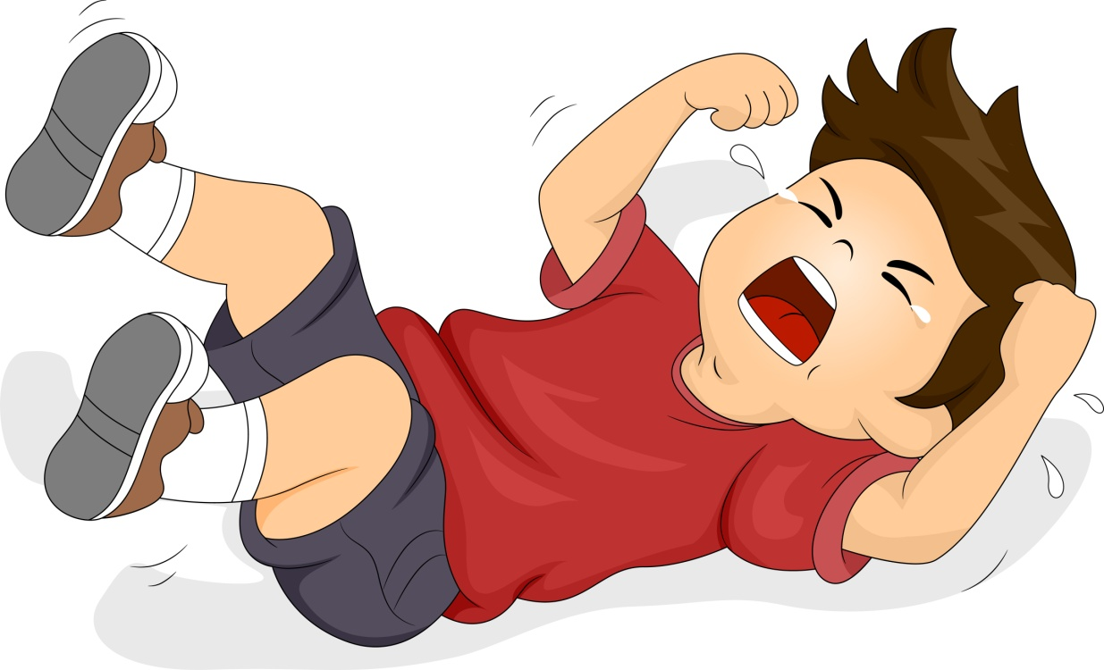
Jonah

Slide 10
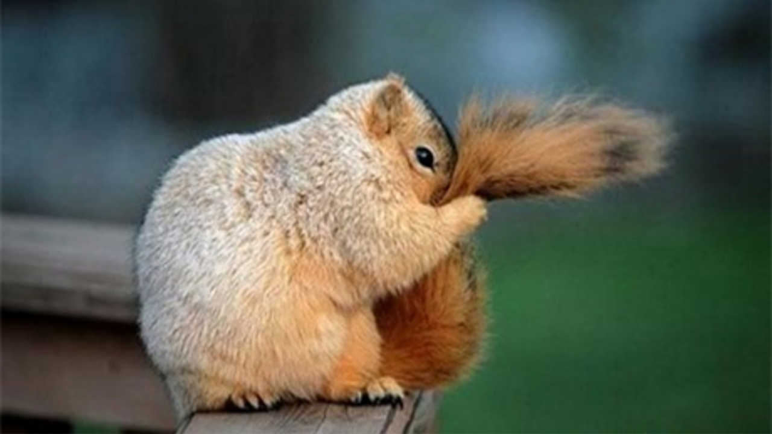
Nicodemus

Slide 11
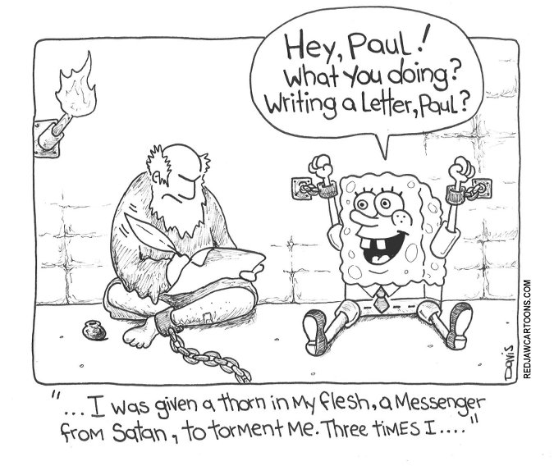
Paul

Slide 12
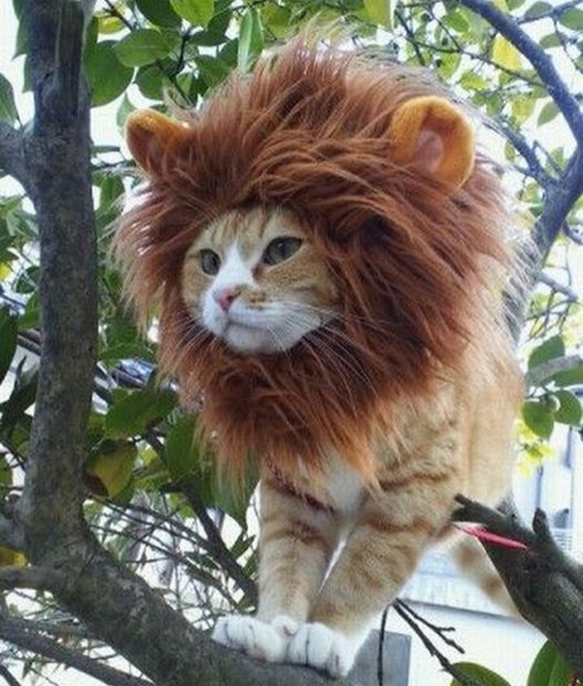
Pretending

