Slide 1
Declaration of Awesome
Chase Pratt
Romeo Church of Christ
5/28/17

Slide 2
Colossians 3:12-14
Therefore, as God’s chosen people, holy and dearly loved, clothe yourselves with compassion, kindness, humility, gentleness and patience. ¹³ Bear with each other and forgive one another if any of you has a grievance against someone. Forgive as the Lord forgave you. ¹⁴ And over all these virtues put on love, which binds them all together in perfect unity.

Slide 3
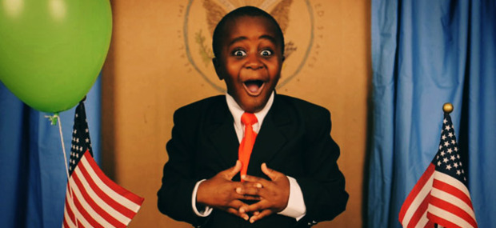
Robby Novak aka Kid President

Slide 4
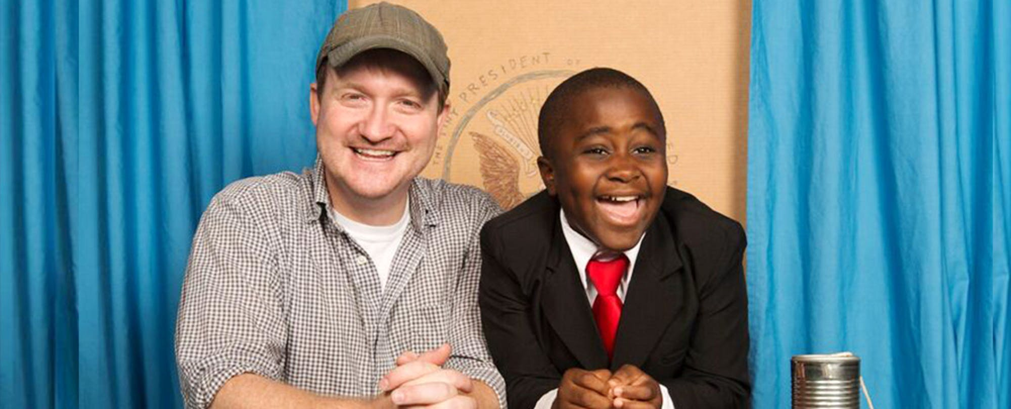
Robby and Brad

Slide 6
Colossians 3:12
Therefore, as God’s chosen people, holy and dearly loved, clothe yourselves with compassion, kindness, humility, gentleness and patience.

Slide 7
What does Awesome look like?
Be like cheese and bacon and make everything you touch better

Slide 8
What does Awesome look like?
Be like cheese and bacon and make everything you touch better
Words can change the world

Slide 9
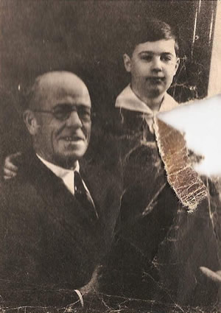
Words can change the world

Slide 10
Words can change the world
Fred McFeely Rogers
Fred Brooks McFeely

Slide 11
Colossians 3:13
Bear with each other and forgive one another if any of you has a grievance against someone. Forgive as the Lord forgave you.

Slide 12
Colossians 3:14
And over all these virtues put on love, which binds them all together in perfect unity.

Slide 13
John 13:34-35
A new command I give you: Love one another. As I have loved you, so you must love one another. ³⁵ By this everyone will know that you are my disciples, if you love one another.

Slide 14
What does Awesome look like?
Be like cheese and bacon and make everything you touch better
Words can change the world
Above all: Love

Slide 15
What does Awesome look like?
Be like cheese and bacon and make everything you touch better
Words can change the world
Above all: Love
**

