Slide 1
If You Is…
Chase Pratt
Romeo Church of Christ
7/1/18

Slide 2
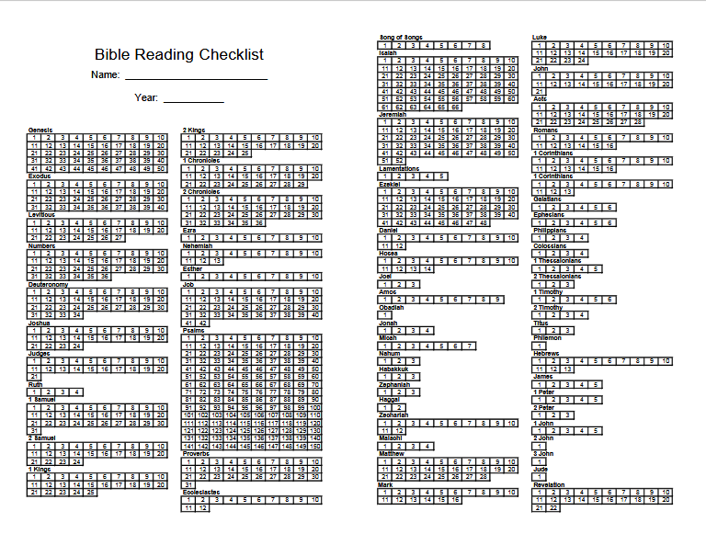

Slide 3
Psalm 75:1-5
We praise you, God, we praise you, for your Name is near; people tell of your wonderful deeds.
² You say, “I choose the appointed time; it is I who judge with equity. ³ When the earth and all its people quake, it is I who hold its pillars firm. ⁴ To the arrogant I say, ‘Boast no more,’ and to the wicked, ‘Do not lift up your horns. ⁵ Do not lift your horns against heaven; do not speak so defiantly.’”

Slide 4
Psalm 75:6-10
No one from the east or the west or from the desert can exalt themselves. ⁷ It is God who judges: He brings one down, he exalts another. ⁸ In the hand of the Lord is a cup full of foaming wine mixed with spices; he pours it out, and all the wicked of the earth drink it down to its very dregs.
⁹ As for me, I will declare this forever; I will sing praise to the God of Jacob, ¹⁰ who says, “I will cut off the horns of all the wicked, but the horns of the righteous will be lifted up.”

Slide 5
“If you have to say you is, you ain’t.”

Slide 6
“If you have to say you is, you ain’t.”
Joe Louis or Jimmy Hoffa or
William Shakespeare or Someone Else

Slide 7
Judges 21:25
In those days Israel had no king; everyone did as they saw fit.

Slide 8
Zephaniah 2:3
Seek the Lord, all you humble of the land, you who do what he commands. Seek righteousness, seek humility; perhaps you will be sheltered on the day of the Lord’s anger.

Slide 9
James 4:6-10
But he gives us more grace. That is why Scripture says:
“God opposes the proud but shows favor to the humble.”
⁷ Submit yourselves, then, to God. Resist the devil, and he will flee from you. ⁸ Come near to God and he will come near to you. Wash your hands, you sinners, and purify your hearts, you double-minded. ⁹ Grieve, mourn and wail. Change your laughter to mourning and your joy to gloom. ¹⁰ Humble yourselves before the Lord, and he will lift you up.

Slide 10
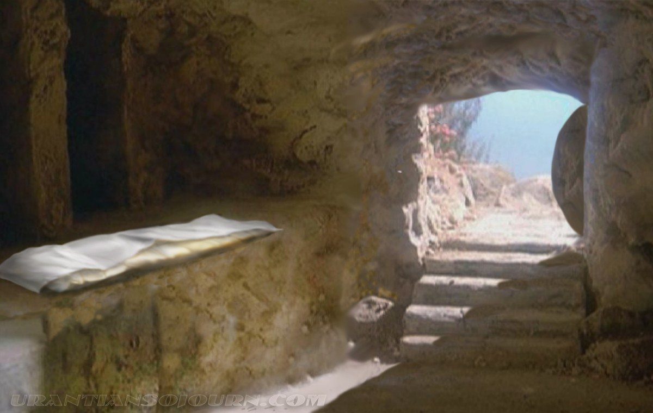

Slide 11
Psalm 75:1-5
We praise you, God, we praise you, for your Name is near; people tell of your wonderful deeds.
² You say, “I choose the appointed time; it is I who judge with equity. ³ When the earth and all its people quake, it is I who hold its pillars firm. ⁴ To the arrogant I say, ‘Boast no more,’ and to the wicked, ‘Do not lift up your horns. ⁵ Do not lift your horns against heaven; do not speak so defiantly.’”
**

