Slide 1
Profiles in Joy
Chase Pratt
Romeo Church of Christ
2/17/19

Slide 2
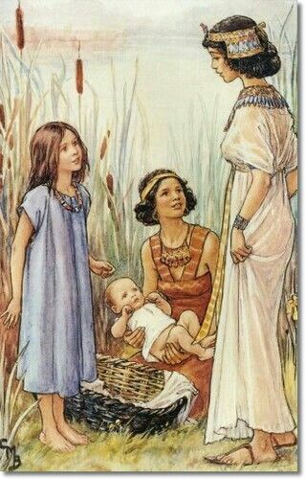
Miriam

Slide 3
Exodus 15:1-3
Then Moses and the Israelites sang this song to the Lord:
“I will sing to the Lord, for he is highly exalted. Both horse and driver he has hurled into the sea.
² “The Lord is my strength and my defense; he has become my salvation. He is my God, and I will praise him, my father’s God, and I will exalt him.

Slide 4
Exodus 15:4-6
The Lord is a warrior; the Lord is his name. ⁴ Pharaoh’s chariots and his army he has hurled into the sea. The best of Pharaoh’s officers are drowned in the Red Sea. ⁵ The deep waters have covered them; they sank to the depths like a stone. ⁶ Your right hand, Lord, was majestic in power. Your right hand, Lord, shattered the enemy.

Slide 5
Exodus 15:20-21
Then Miriam the prophet, Aaron’s sister, took a timbrel in her hand, and all the women followed her, with timbrels and dancing. ²¹ Miriam sang to them:
“Sing to the Lord, for he is highly exalted. Both horse and driver he has hurled into the sea.”

Slide 6
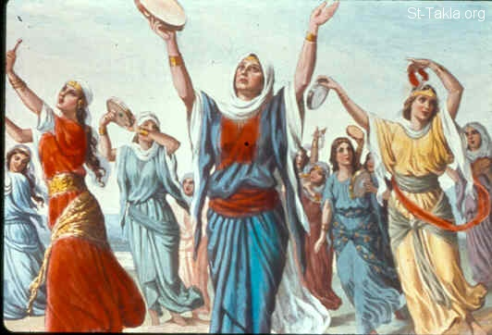

Slide 7
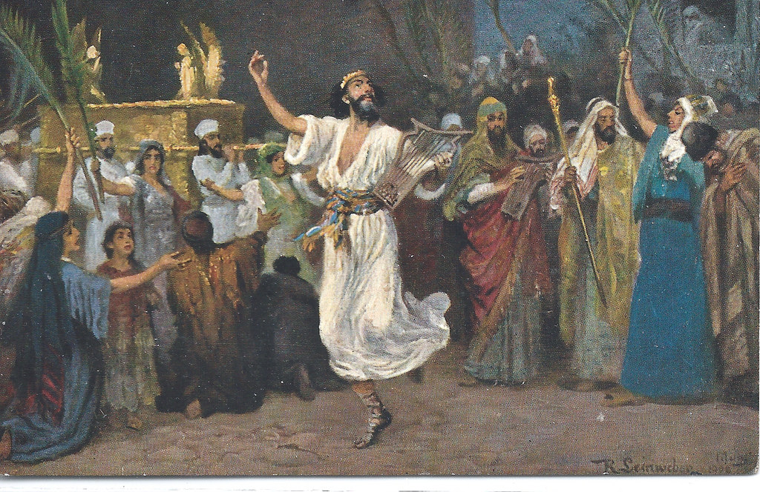
David

Slide 8
Psalm 21:1-4
The king rejoices in your strength, Lord. How great is his joy in the victories you give!
² You have granted him his heart’s desire and have not withheld the request of his lips.^{[b]} ³ You came to greet him with rich blessings and placed a crown of pure gold on his head. ⁴ He asked you for life, and you gave it to him— length of days, for ever and ever.

Slide 9
Psalm 6:1-3
Lord, do not rebuke me in your anger or discipline me in your wrath. ² Have mercy on me, Lord, for I am faint; heal me, Lord, for my bones are in agony. ³ My soul is in deep anguish. How long, Lord, how long?

Slide 10
Psalm 6:6-7
I am worn out from my groaning.
All night long I flood my bed with weeping and drench my couch with tears. ⁷ My eyes grow weak with sorrow; they fail because of all my foes.

Slide 12
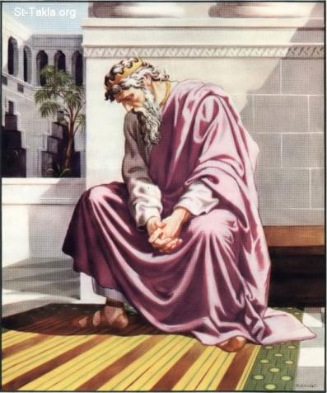

Slide 13
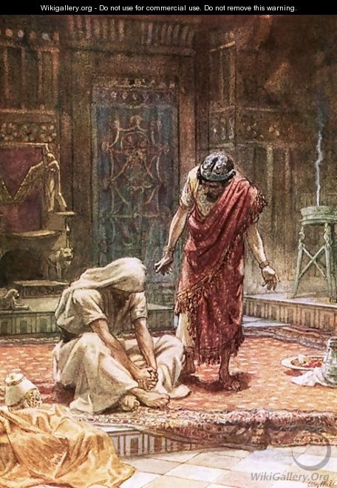

Slide 14
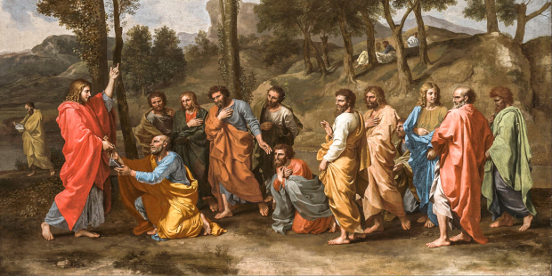
Jesus’ Disciples

Slide 15
Acts 13:52
And the disciples were filled with joy and with the Holy Spirit.

Slide 17
1st Peter 5:12-16
Dear friends, do not be surprised at the fiery ordeal that has come on you to test you, as though something strange were happening to you. ¹³ But rejoice inasmuch as you participate in the sufferings of Christ, so that you may be overjoyed when his glory is revealed. ¹⁴ If you are insulted because of the name of Christ, you are blessed, for the Spirit of glory and of God rests on you. ¹⁵ If you suffer, it should not be as a murderer or thief or any other kind of criminal, or even as a meddler. ¹⁶ However, if you suffer as a Christian, do not be ashamed, but praise God that you bear that name

Slide 18
James 1:2-4
Consider it pure joy, my brothers and sisters, whenever you face trials of many kinds, ³ because you know that the testing of your faith produces perseverance. ⁴ Let perseverance finish its work so that you may be mature and complete, not lacking anything.

Slide 19
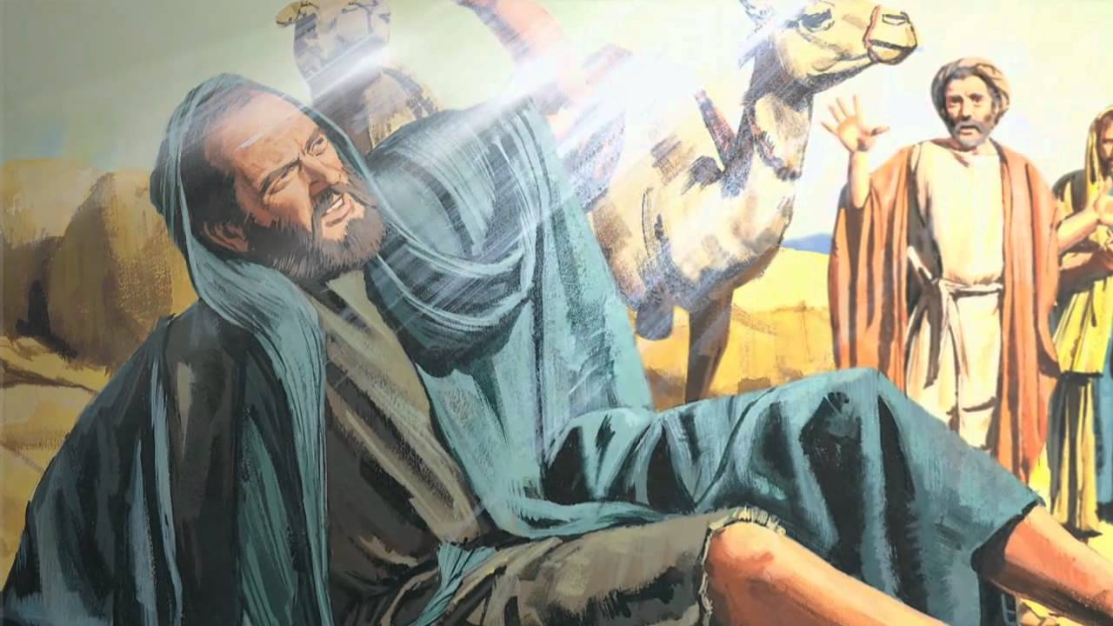
Paul

Slide 20
Romans 15:7-9a
Accept one another, then, just as Christ accepted you, in order to bring praise to God. ⁸ For I tell you that Christ has become a servant of the Jews on behalf of God’s truth, so that the promises made to the patriarchs might be confirmed ⁹ and, moreover, that the Gentiles might glorify God for his mercy.

Slide 21
Romans 15:9b-12
As it is written:
“Therefore I will praise you among the Gentiles; I will sing the praises of your name.”
¹⁰ Again, it says,
“Rejoice, you Gentiles, with his people.”
¹¹ And again,
“Praise the Lord, all you Gentiles; let all the peoples extol him.”
¹² And again, Isaiah says,
“The Root of Jesse will spring up, one who will arise to rule over the nations; in him the Gentiles will hope.”

Slide 22
Romans 15:13
May the God of hope fill you with all joy and peace as you trust in him, so that you may overflow with hope by the power of the Holy Spirit.

Slide 23
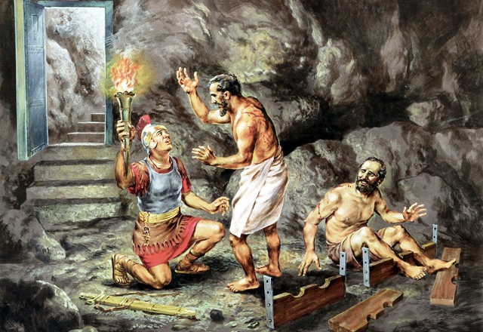

Slide 24
Acts 16:33-34
At that hour of the night the jailer took them and washed their wounds; then immediately he and all his household were baptized. ³⁴ The jailer brought them into his house and set a meal before them; he was filled with joy because he had come to believe in God—he and his whole household.
**

