Slide 1
Putting a Bow On It
Chase Pratt
Romeo Church of Christ
12/30/18

Slide 2
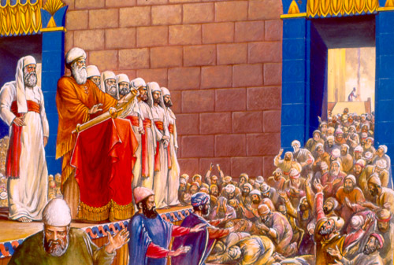

Slide 3
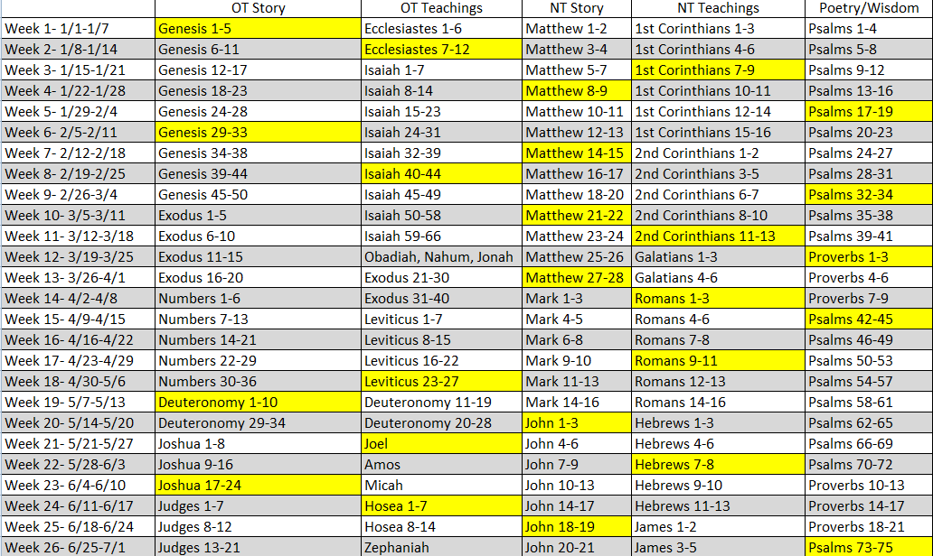

Slide 6
Psalm 150
Praise the Lord.
Praise God in his sanctuary; praise him in his mighty heavens. ² Praise him for his acts of power; praise him for his surpassing greatness. ³ Praise him with the sounding of the trumpet, praise him with the harp and lyre, ⁴ praise him with timbrel and dancing, praise him with the strings and pipe, ⁵ praise him with the clash of cymbals, praise him with resounding cymbals.
⁶ Let everything that has breath praise the Lord.
Praise the Lord.

Slide 7
Zechariah 14:20-21
On that day holy to the Lord will be inscribed on the bells of the horses, and the cooking pots in the Lord’s house will be like the sacred bowls in front of the altar. ²¹ Every pot in Jerusalem and Judah will be holy to the Lord Almighty, and all who come to sacrifice will take some of the pots and cook in them. And on that day there will no longer be a Canaanite^{[c]} in the house of the Lord Almighty.

Slide 8
Malachi 4:2-6
But for you who revere my name, the sun of righteousness will rise with healing in its rays. And you will go out and frolic like well-fed calves. ³ Then you will trample on the wicked; they will be ashes under the soles of your feet on the day when I act,” says the Lord Almighty.
⁴ “Remember the law of my servant Moses, the decrees and laws I gave him at Horeb for all Israel.
⁵ “See, I will send the prophet Elijah to you before that great and dreadful day of the Lord comes. ⁶ He will turn the hearts of the parents to their children, and the hearts of the children to their parents; or else I will come and strike the land with total destruction.”

Slide 9
Revelation 22:12-17
“Look, I am coming soon! My reward is with me, and I will give to each person according to what they have done. ¹³ I am the Alpha and the Omega, the First and the Last, the Beginning and the End.
¹⁴ “Blessed are those who wash their robes, that they may have the right to the tree of life and may go through the gates into the city. ¹⁵ Outside are the dogs, those who practice magic arts, the sexually immoral, the murderers, the idolaters and everyone who loves and practices falsehood.
¹⁶ “I, Jesus, have sent my angel to give you this testimony for the churches. I am the Root and the Offspring of David, and the bright Morning Star.”
¹⁷ The Spirit and the bride say, “Come!” And let the one who hears say, “Come!” Let the one who is thirsty come; and let the one who wishes take the free gift of the water of life.

Slide 10
Acts 28:30-31
For two whole years Paul stayed there in his own rented house and welcomed all who came to see him. ³¹ He proclaimed the kingdom of God and taught about the Lord Jesus Christ—with all boldness and without hindrance!

Slide 11
**

