Slide 1
White and Nerdy
Chase Pratt
Romeo Church of Christ
3/11/18

Slide 2
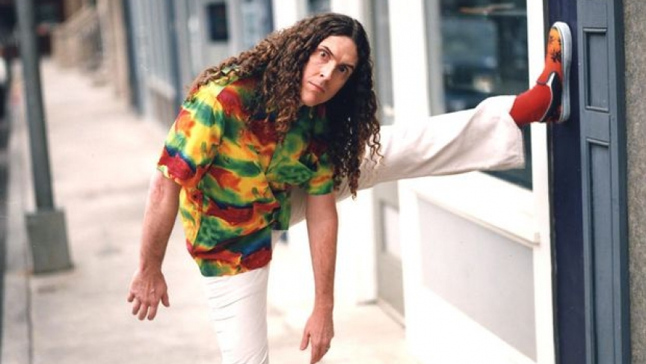

Slide 3
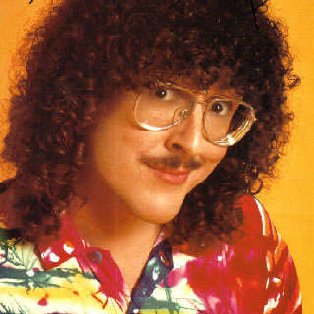

Slide 4
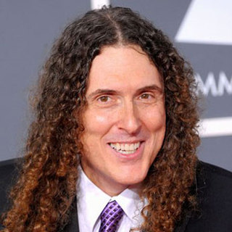

Slide 6
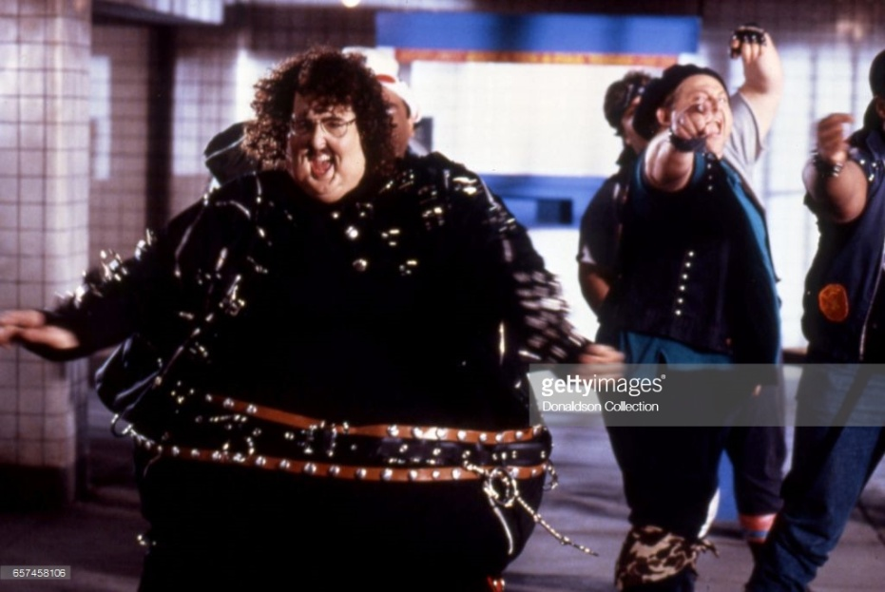

Slide 9
Dare to Be Stupid
Lame Claim to Fame
First World Problems
If That Isn’t Love
The Saga Begins
This is the Life
Callin’ In Sick
Everything You Know is Wrong
Water is Wet
Close But No Cigar
Since You’ve Been Gone
Whatever You Like
White and Nerdy

Slide 10
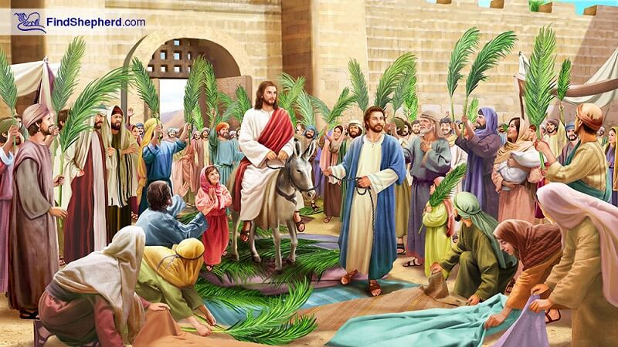

Slide 12
**

